Slide 1

Presenter’s Information
👤 Student Name: Moeez Ur Rahman
📜 Student Roll Number: 3245
📓 Course Management System Number: F24-BSAI-0036
💻 Department: Department of Computing & Innovation
🎓 Programme: Bachelor of Science in Artificial Intelligence
📚 Course: Computer Organisation and Assembly Language
🏫 Course Code: CS2213

Slide 2
Project Presentation
Project Title: Vault
(Simple Banking System)

Slide 3
Existing System
Spread Sheet Based Banking Records
Commercial Banking Software
Online Banking Systems
Mixed Banking System

Slide 4
Problem Statement
Account & Finance systems are mostly implemented in high-end programming languages and can be difficult to analyse due to their complexity.
There seems to be a need for an intermediate-level academic project that demonstrates basic banking operations while applying core concepts of Computer Organisation and Assembly Language.

Slide 5
Proposed Solution
The solution to that made-up problem is Vault. A simple banking system developed using EMU8086 Assembly Language on emu8086 emulator.
Focuses on learning assembly language and computer organisation concepts.

Slide 6
Functionalities & Concepts Used
Array
Storing Account Data
Logical Flow Control
Validation
Conditional Jump
Decision Making
Input Validation
Memory Addressing
Access Account Data
Update Balances
Loop
Menu Repetition
Transaction Flow
Register
Calculations
Temporary Data Storage
Balance Updates
Arithmetic Instruction
Deposit
Withdrawal
Balance Updates
DOS Interrupt
Input & Output
Display Prompts
Read User Input
Comparison Instruction
Check Withdrawal
Available Balance
Validate Limits

Slide 7
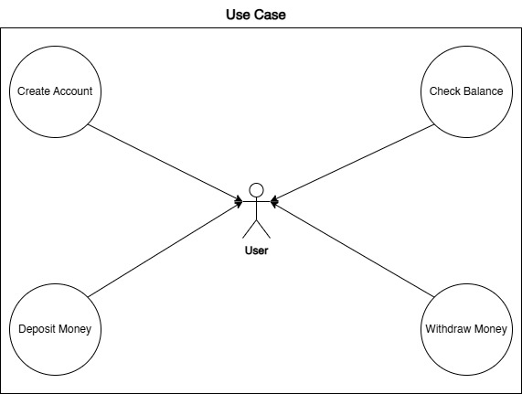

Slide 8
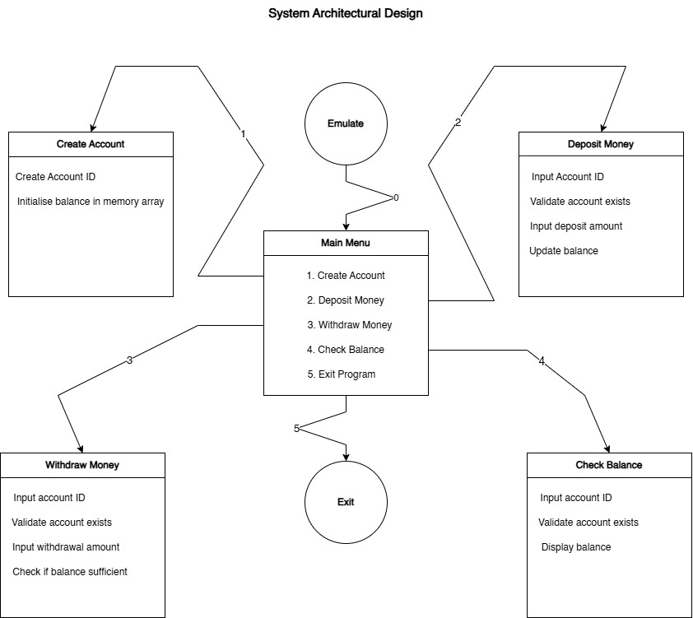

Slide 9
Project Outcome

Slide 10
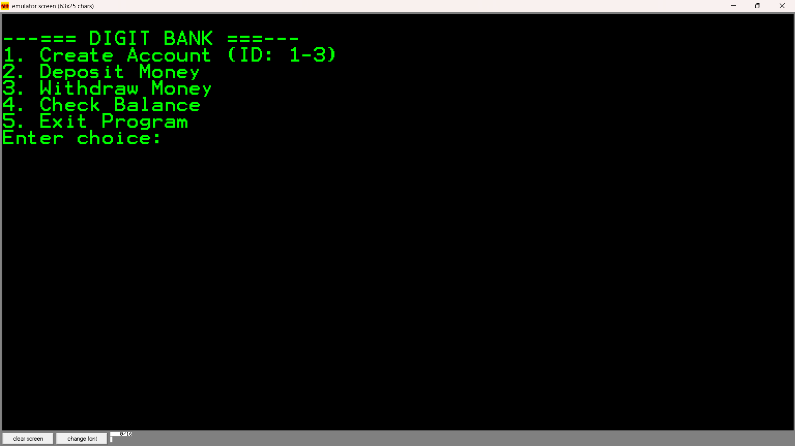

Slide 11
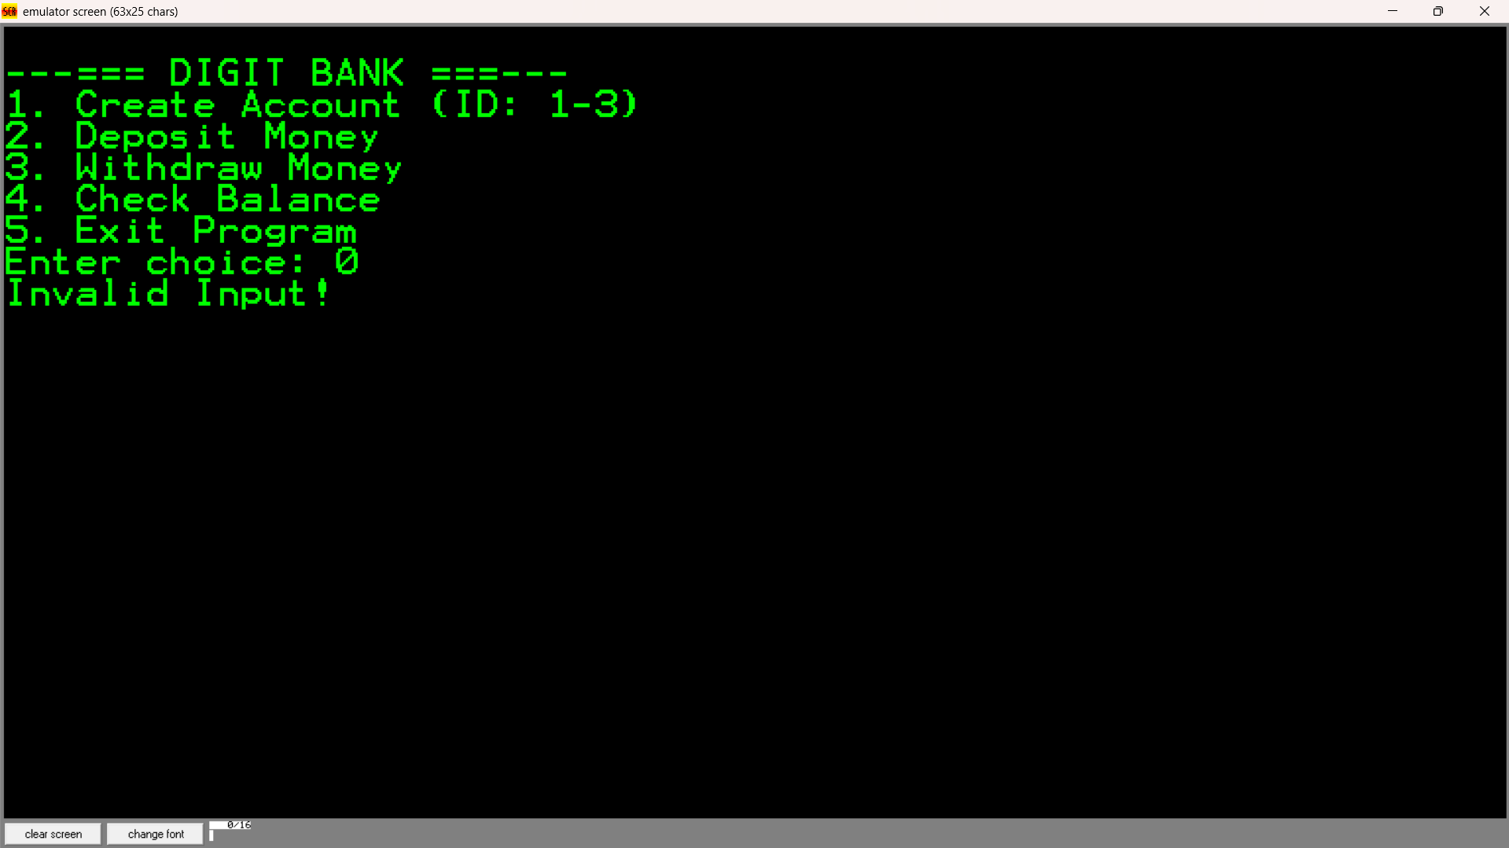

Slide 12
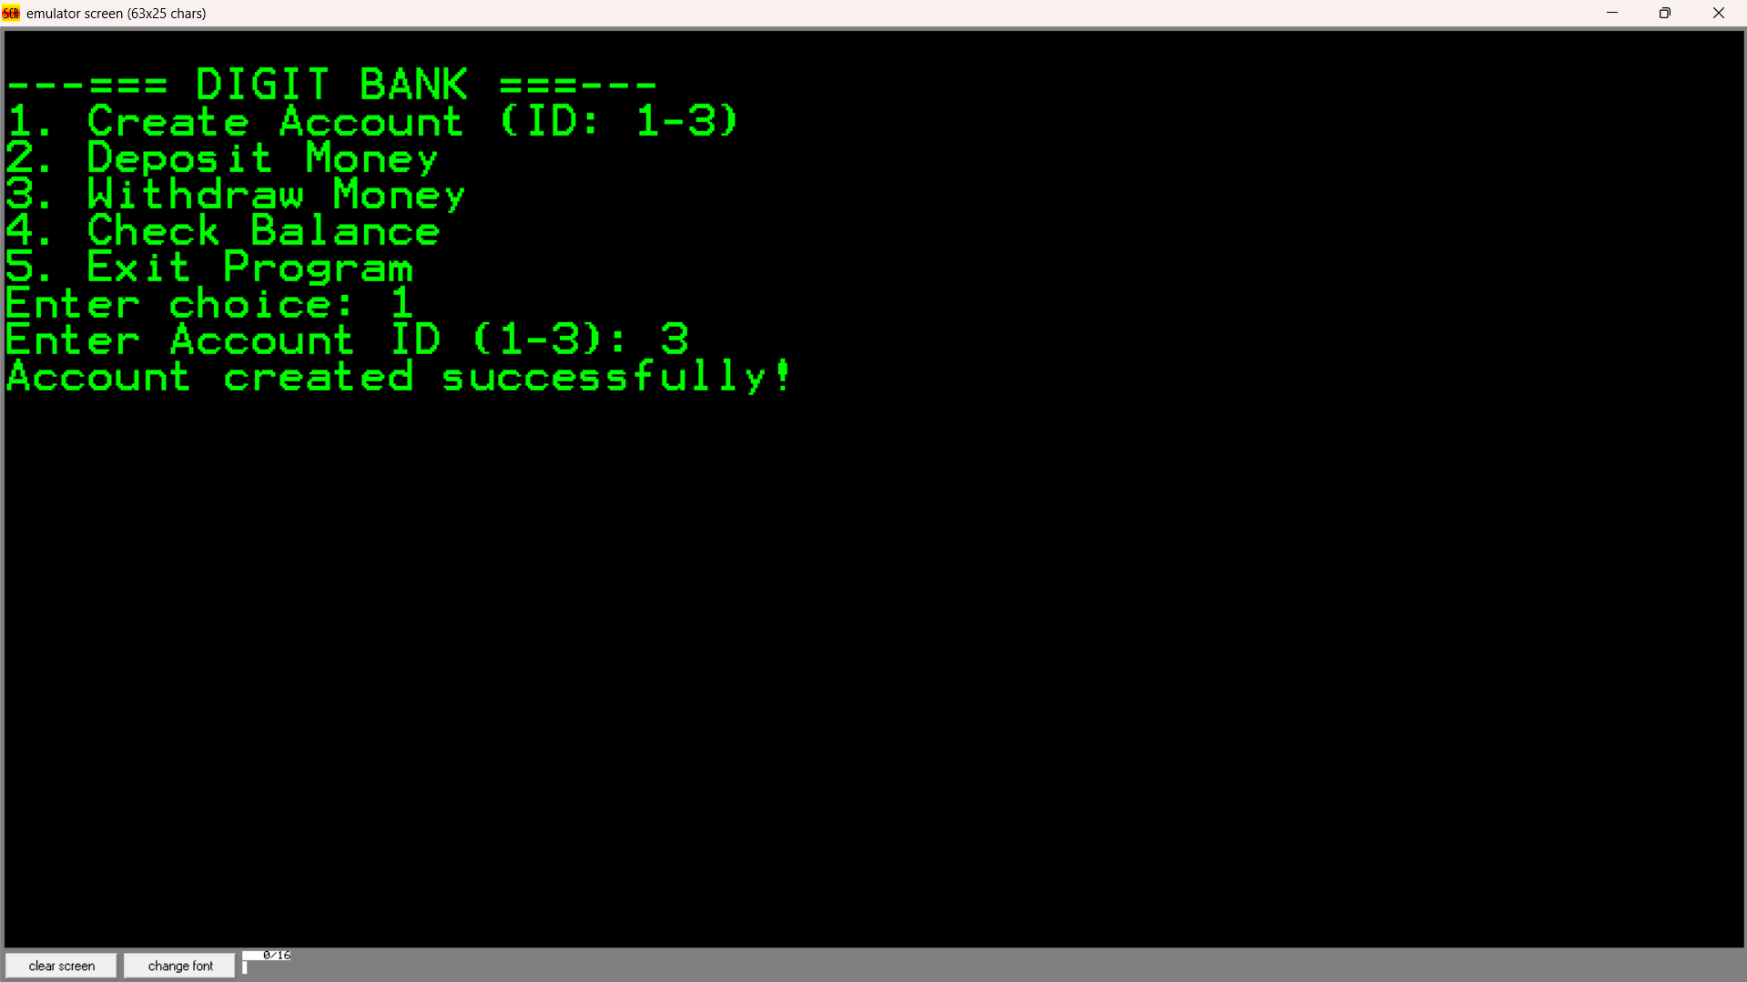

Slide 13
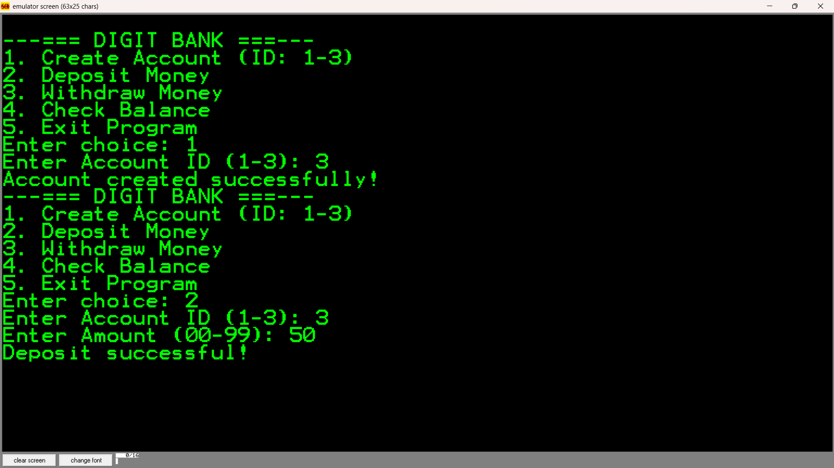

Slide 14
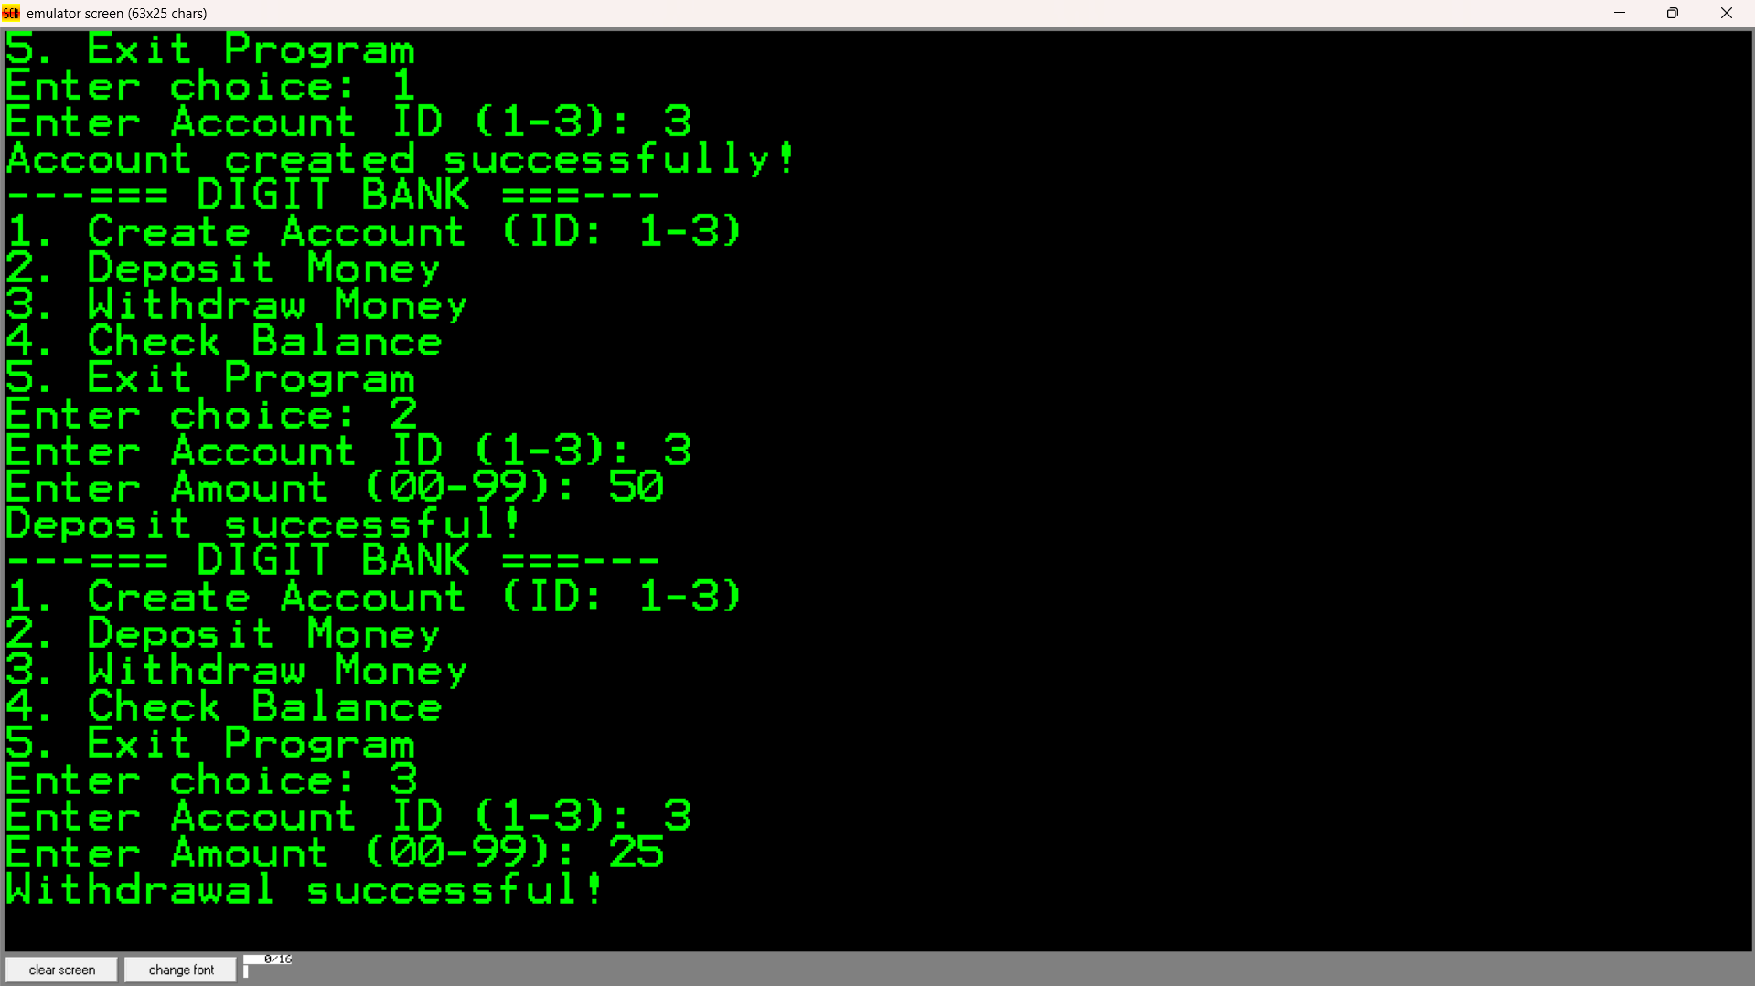

Slide 15
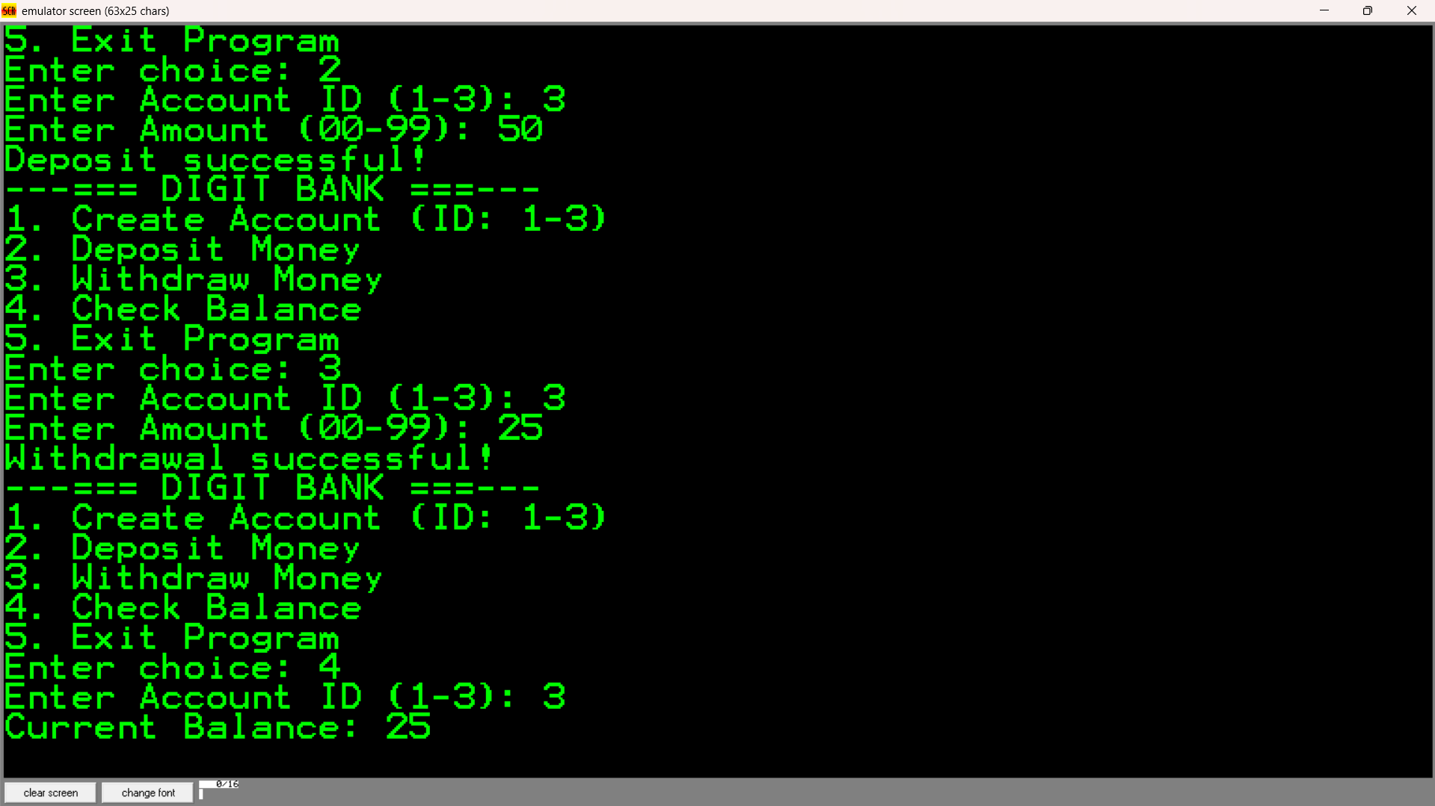

Slide 16
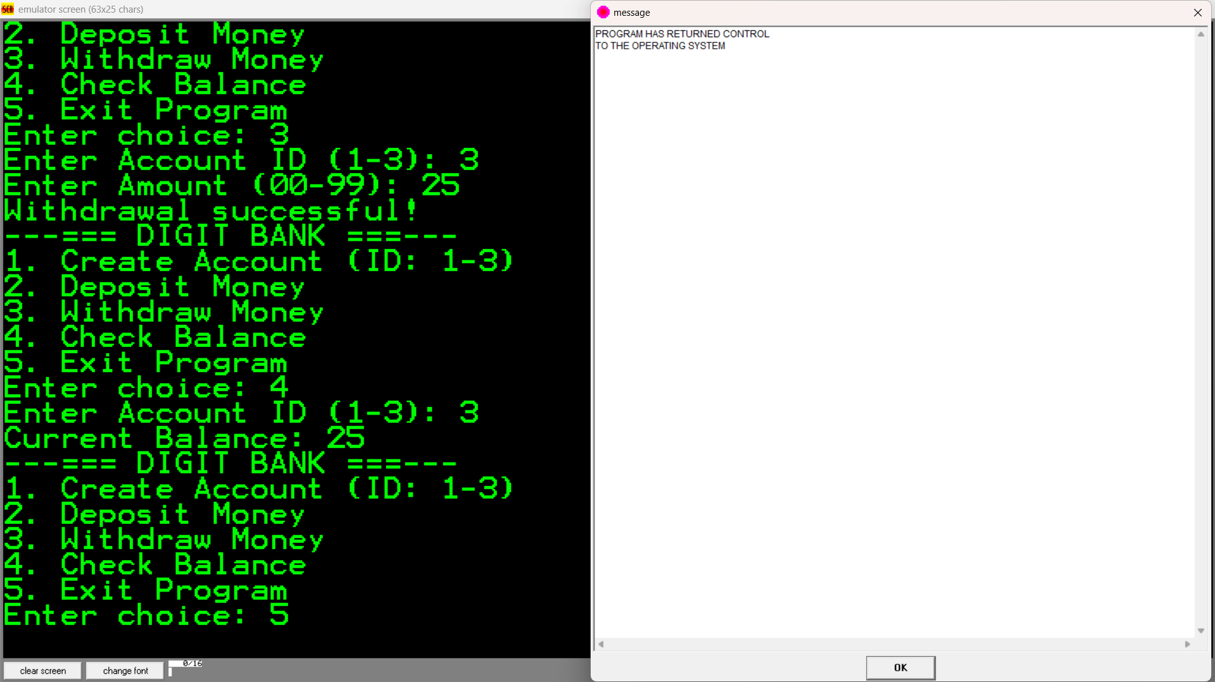

Slide 17
A fully working banking simulation on EMU8086
Correct balance updates using assembly instructions
Clear console-based user interaction
Better understanding of low-level system implementation
Educational Value
Demonstrates real-world system in assembly
Strengthens COAL concepts
Improves understanding of hardware-software relation
Ideal intermediate-level project

Slide 18
Limitations
Single or two-digit amounts only
No permanent storage (RAM only)
Basic security
Limited user interface

Slide 19
Potential Enhancements
Support multi-digit amounts
Add file storage
Add interest calculation
Improve UI design

Slide 20
Conclusion
VAULT – A Simple Banking System
• Vault successfully simulates core banking operations
• Applies core COAL concepts practically
• Bridges gap between theory and practice
• Enhances low-level programming skills

Slide 21




That’s all folks!
bye bye
Meme:

